Slide 1
HTML5 Media

Slide 2
Media Elements
HTML5 introduced new markup to embed media on page
No 3rd party plugins for the same

Slide 3
New Elements
<audio>
<video>

Slide 4
In Past
<object width="100" height="100" data="player.swf">
<param name ="movie" value="player.swf“>
</object>

Slide 5
Code : 01
<video
src="dizzy.mp4"
width="300"
height="200“
>
</video>

Slide 6
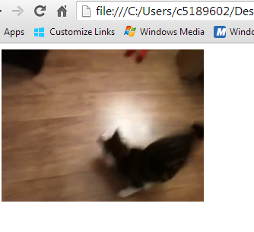
Output :Code01

Slide 7
Fallback for no video support
<video
src="dizzy.mp4"
width="300"
height="200“
>
Video Tag Not Supported
</video>

Slide 8
Code:02
<video
src="dizzy.mp4"
width="300"
height="200“
autoplay // this may not work in mobiles
>
</video>

Slide 9
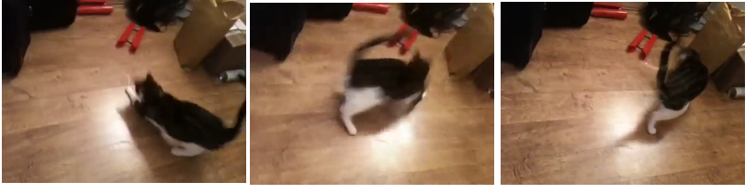
Output:code02

Slide 10
Code:03
<video
src="dizzy.mp4"
width="300"
height="200“
controls // this provides set of controls
>
</video>

Slide 11
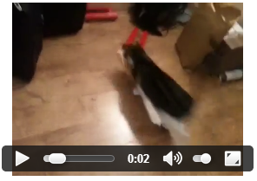
Output:code03

Slide 12
specifies that video should start over again, every time it is finished
<video
src="dizzy.mp4"
width="300"
height="200“
loop
>
</video>

Slide 13
Specifies an image that should be shown while downloading the video, or user hits play
<video
src="dizzy.mp4"
width="300"
height="200“
poster =“<URL>”
>
</video>

Slide 14
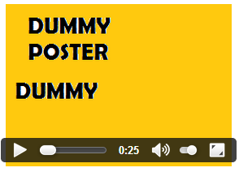
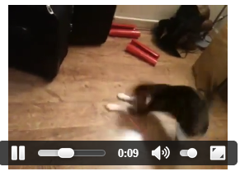

Slide 15
Containers & Codecs
containers as a type of publication: a hardback book, a glossy magazine, a newspaper, a pamphlet, a gum wrapper - all of which can contain words and other things like photographs, or cartoons, and yet each one works in a different way.
codec as the way of displaying the information you want in your publication

Slide 16
Containers & Codecs
Assume comic book written on bubble gum wrapper. No one would read it. Instead it would good for reading it in a comic style
Every video application has a proper codec and container

Slide 17
Containers & Codec
A codec is a method for encoding or decoding data--specifically, compressed data. The term was originally a shortened form ofcompressor-decompressor. That's what codecs do: they take digital media data and either compress them (for transport and storage) or decompress them (for viewing or transcoding.)
Once the media data is compressed into suitable formats and reasonable sizes, it needs to be packaged, transported, and presented. That's the purpose of container formats--to be discrete "black boxes" for holding a variety of media formats

Slide 18
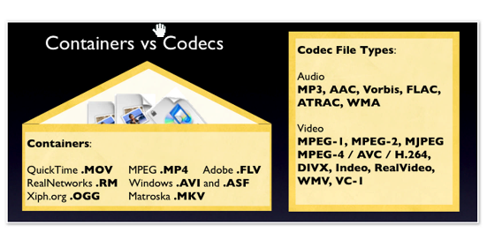
Containers & Codec

Slide 19
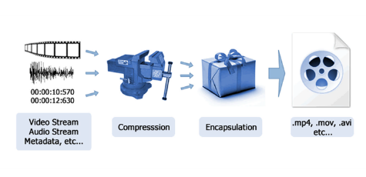
Containers & Codec

Slide 20
Video Codecs
H.262
Ogg Theora
VP8(WebM)

Slide 21
Adding Multiple source
<video
width="300"
height="200“
>
<source src=“file.mov”/>
<source src=“file.ogv”/>
<source src=“file.webm”/>
</video>

Slide 22
Type = “video/container;codecs=value”
<video
width="300"
height="200“
>
<source type = “video/ogg;codecs = theora,vorbis” />
<source type = “video/webm;codecs = vp8,vorbis” />
</video>

Slide 23
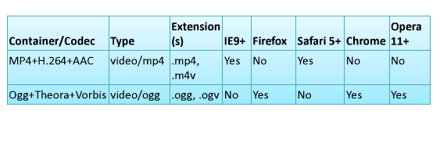
Browser support

Slide 24
AUDIO Tag
  <audio> </audio>

Slide 25
Fallback
Text inside audio tag
<audio>
  Browser does not support audio file
  </audio>

Slide 26
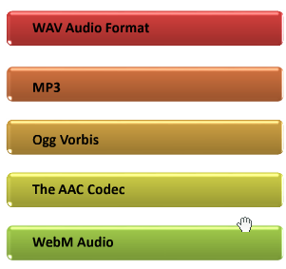
Audio Codec

Slide 27
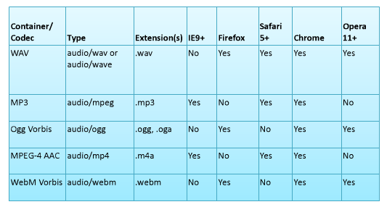
Browser support

Slide 28
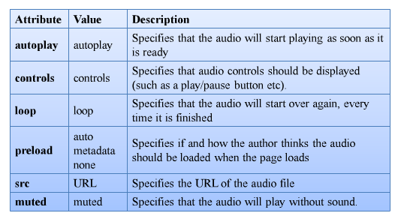
Audio Attributes

Slide 29
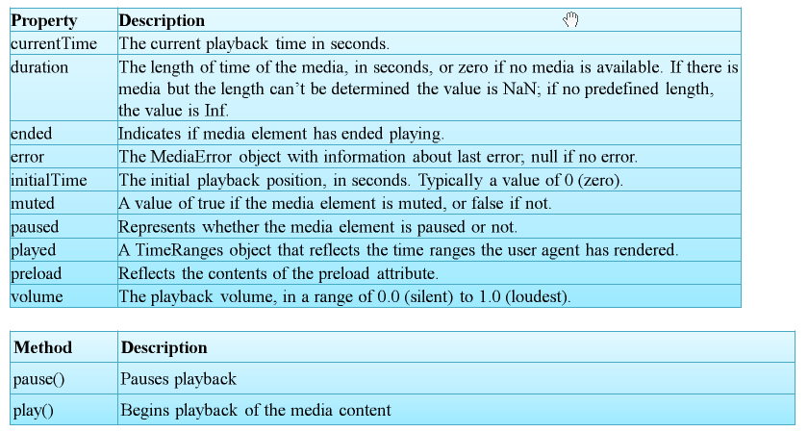
Media Methods and Props

